Slide 1
In Vitro Neural Implant Tester with Hardware-In-The-Loop Simulation
Neuralink, US 2023/0147266 A1, Published 5/11/2023
6/10/2024

Slide 2
Background
Functionality of the implantable device depends on active electronic devices
Body environments (e.g., brain tissue) have high humidity and bodily fluids
Implantable devices in-vivo (inside organism) environment with high humidity and oxidative inflammatory response puts stress on sensitive components like active electronic devices
Need failure analysis for implantable devices to determine an implantation period
Need to test large number of devices
Need to accurately replicate in-vivo conditions in a testing environment
Implanted devices take years to fail – need more time-efficient testing environment

Slide 3
Outline
Goal: Describe accelerated testing apparatuses for implants to stimulate the circulation of bodily fluids via performing accelerated aging tests of many wireless neural implants simultaneously
Purpose: To determine the implantation period of each implant via accelerated testing in simulated in-vivo environments for many implants at once
Embodiments:
Accelerated Testing Apparatus
Vessel + Fixtures of Accelerated Testing Apparatus
Closed vessel of Accelerated Testing Appratus
Fixture with Yoked Parts
Side View of Fixture
Front view of Accelerated Testing Apparatus
Flowchart

Slide 4
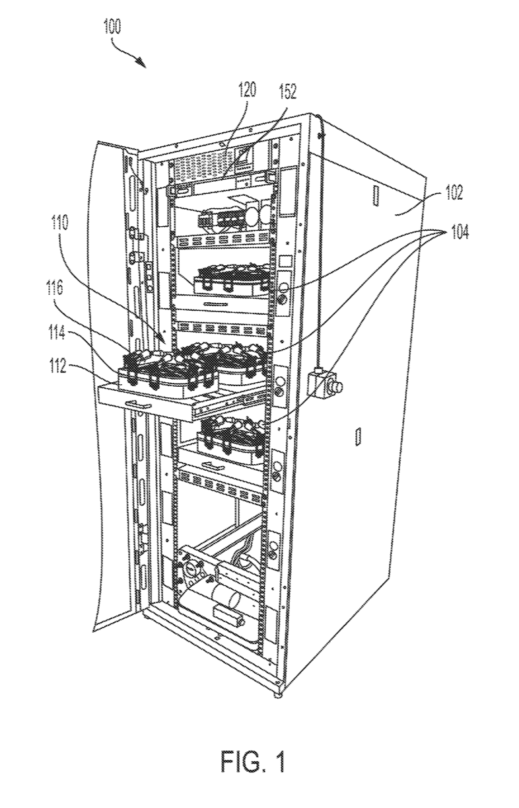

Accelerated Testing Apparatus
- Computer server coupled with antenna for communication with devices-under-test
- Data (e.g., internal physical properties) of devices-under-test continuously received, indexed by computer server
- Can include multiple computer servers
Placed on shelf Insertable/removable
3D printed
Modular, “substantially similar”
Holds 200 mL of liquid
Computer server
Antenna
Vessel
Cabinet
(18U or greater size server rack)
Force together lid & watertight basin to hermetically seal vessel
Latching mechanism
(e.g., clamp, latch)
Multiple Bays
RF transparent lid
Watertight basin

Slide 5
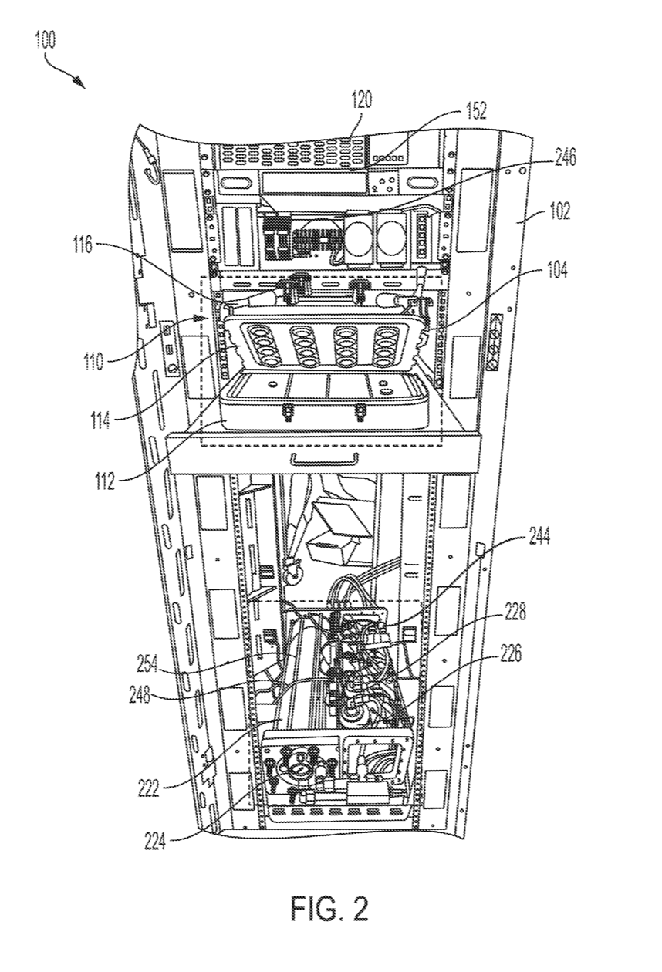




Front view of Accelerated Testing Apparatus
Computer server
Antenna
Controller:
Pulse pressure from pump to induce & exaggerate cyclic mechanical fatigue
Maintain pressure within a yield stress to decrease time to failure, without non-reversible effects
Vessel + Reservoir:
Share common liquid
Pressurized to at least 202,650 pascals (2 atm)
pH of liquid: 7.4
Ionic concentration 6000 microsiemens/cm
Controller
Vessel:
Holds 200mL of liquid
Latching mechanism
Cabinet
Multiple Bays
Vessel
Peroxide dispenser:
Connected with computer server, which commands dispensing peroxide from peroxide dispenser (e.g., stop dispensing if max limit reached, start dispensing if min limit reached)
Peroxide sensor:
Measures pH, ionic concentration, temperature, or pressure
Peroxide – allow temperature acceleration without unrealistic failure
Peroxide concentration: higher than in-vivo levels, without unrealistic failure (e.g., 2.5 millimolars)
RF transparent lid (open)
Watertight basin
Peroxide dispenser
Pump
Pump:
Pump liquid from reservoir to vessel
Circulates constantly replenishing liquid, similar to brain fluid (rather than using a heating stationary liquid replaced every couple of days)
Metal portions
Heater
Reservoir:
Includes liquid with properties similar of cerebral spinal fluid (CSF)
Synthetic CSF – chemically mimic in-vivo environment via solvent pH, ionic strength, conductivity, reactive oxygen species
Holds 8L of liquid
Peroxide sensor
Reservoir
Heater:
Heat liquid to above body temperature (e.g., 37 to 57C), just enough to fail realistically
Immersion heater (metal portions along immersion length of immersion heater coated in polymer)
Pressure Sensor
Disposed on external surface of reservoir
Measure pressure between reservoir and vessel

Slide 6
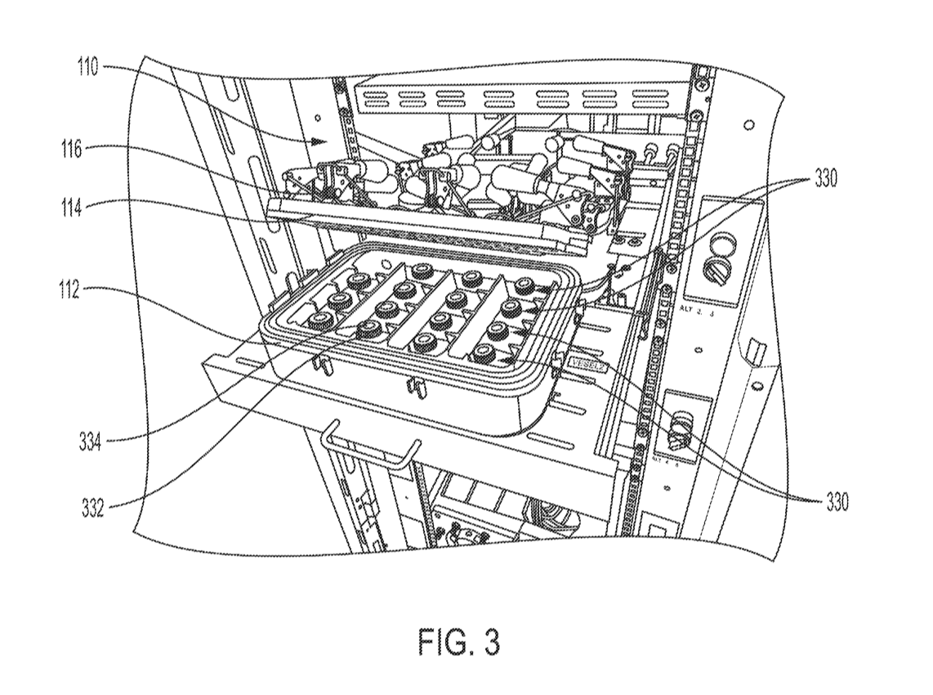
Vessel + Fixtures of Accelerated Testing Apparatus
Vessel
Latching mechanism
Fixtures
(e.g., 16 fixtures per vessel, each fixture holds device-under-test)
RF transparent lid
Watertight basin
(e.g., )
Power transmission coil
- Powers respective device-under-test within fixture, provide wireless charging
Fixtures
Dock

Slide 7
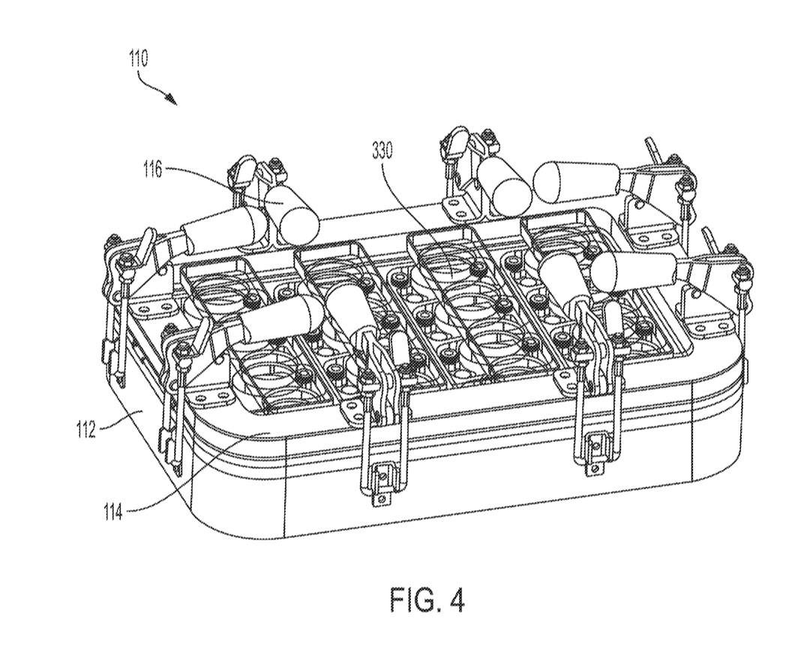
Closed vessel of Accelerated Testing Apparatus
Fixture
Latching mechanism
Watertight basin
RF transparent lid

Slide 8
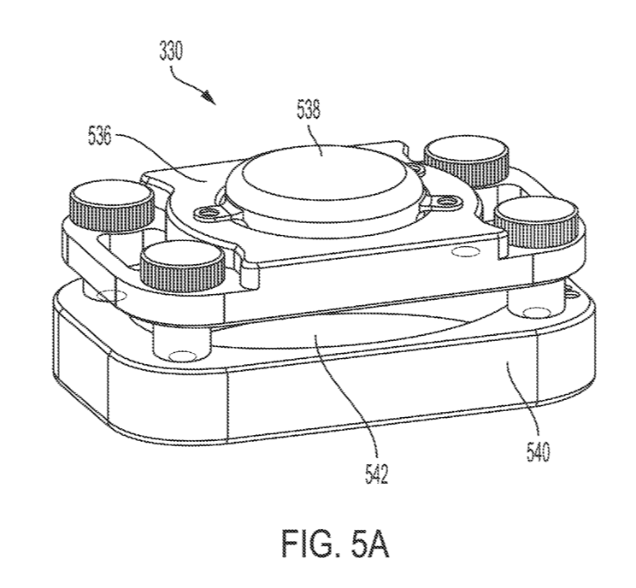
Fixture with Yoked Parts
Device well
First part
Simulated tissue
Second part

Slide 9
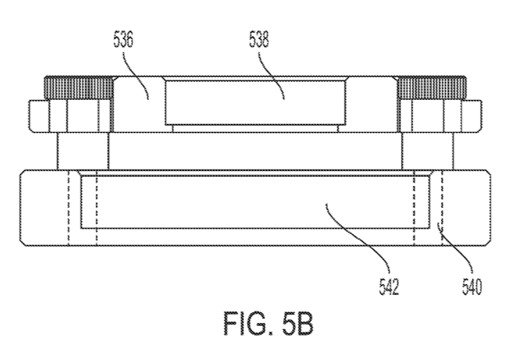
Side view of Fixture
First part
Device well (body)
Simulated tissue well
(electrodes)
Second part
Electrodes – sewn into brain-like material (conductive agarose) to mimic mechanical stresses of electrodes

Slide 10
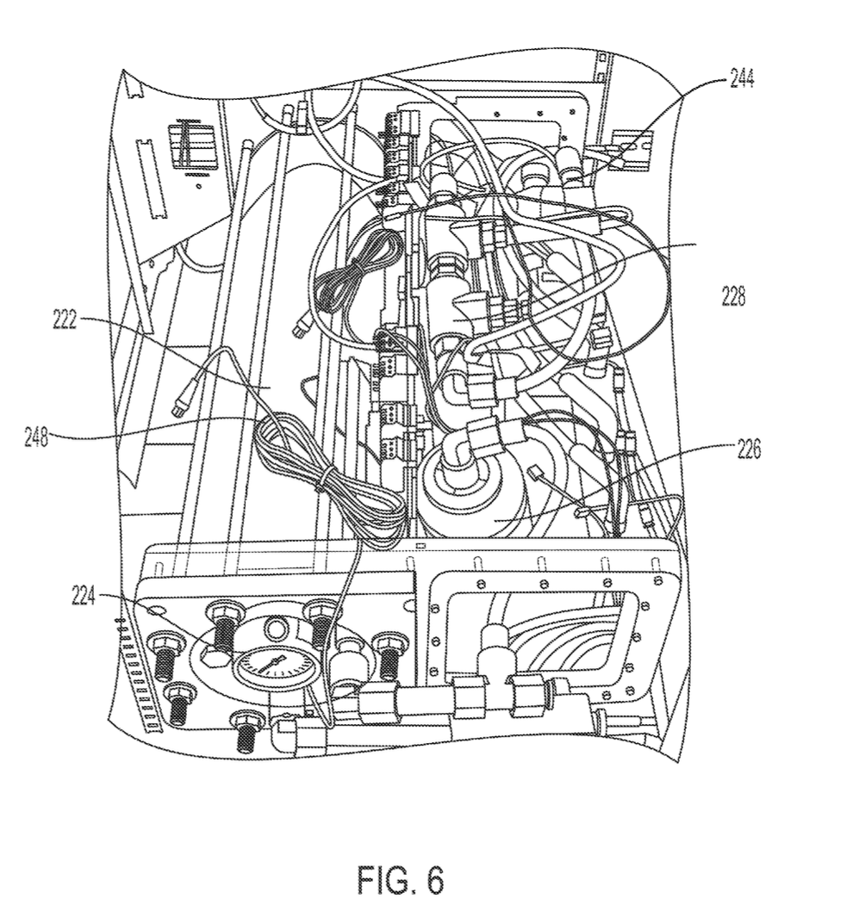
Reservoir + Other Components of Accelerated Testing Apparatus
Peroxide dispenser
Pump
Reservoir
Peroxide sensor
Heater
Pressure Sensor
(may measure pH, ionic concentration, temperature of liquid within reservoir)

Slide 11
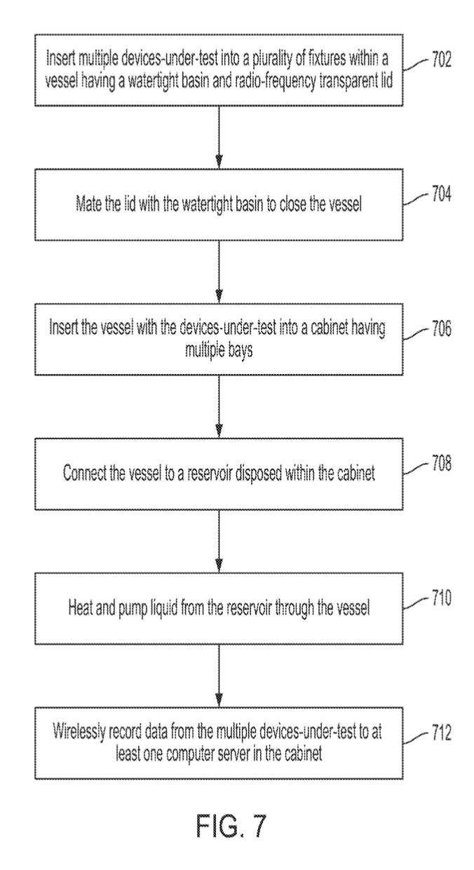
Flowchart

